Slide 2
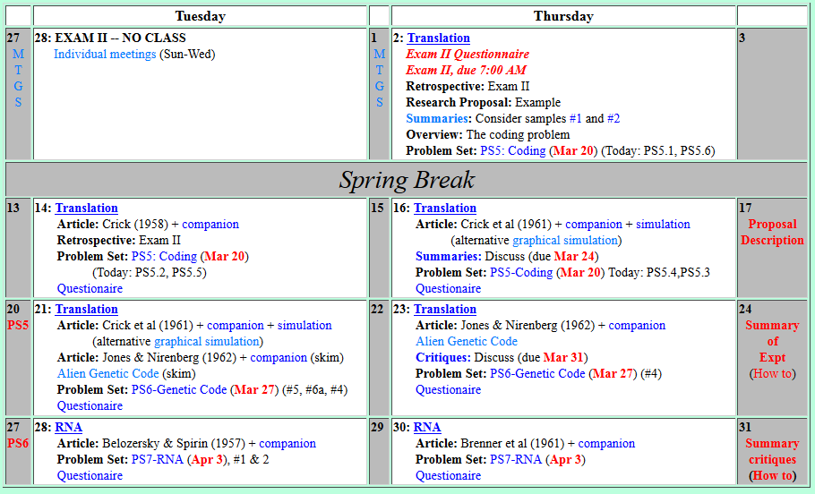


Welcome to Molecular Biology Through Discovery Tuesday, 14 March 2017
…Is the proposal description due Friday follow the same guidelines as fall 2013

Slide 3
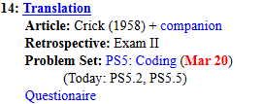
Welcome to Molecular Biology Through Discovery Tuesday, 14 March 2017

Slide 4
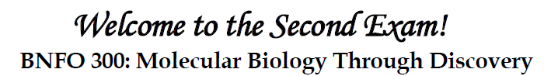
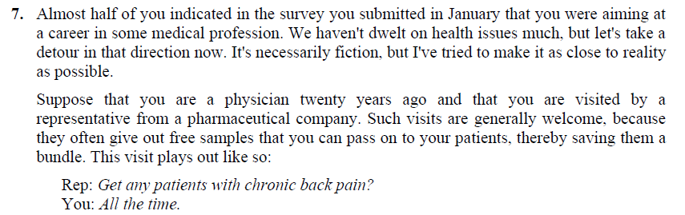
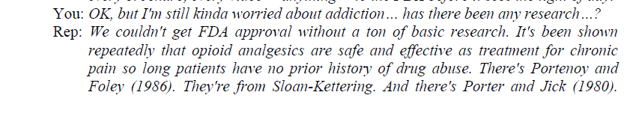

Slide 5
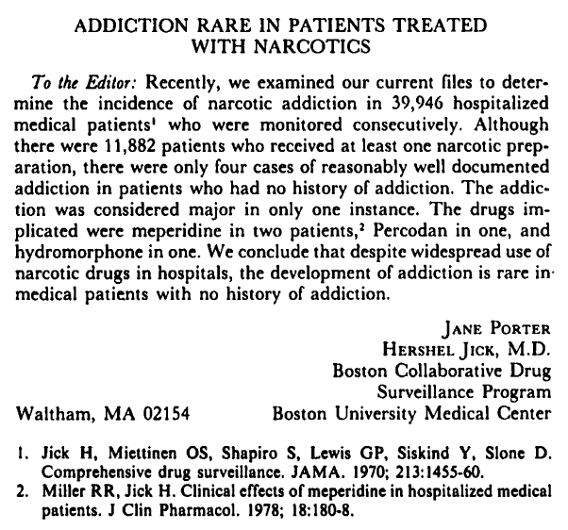
11,882 with narcotic
39,946 patients
4 addictions
Meperidine percodan hydro-morphone

Slide 6
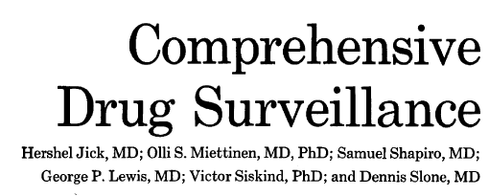
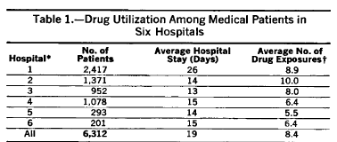
39,946 patients

Slide 7
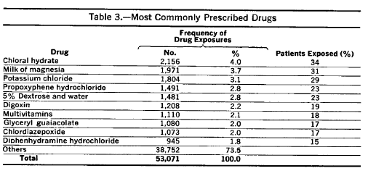
Oxycodone?

Slide 8
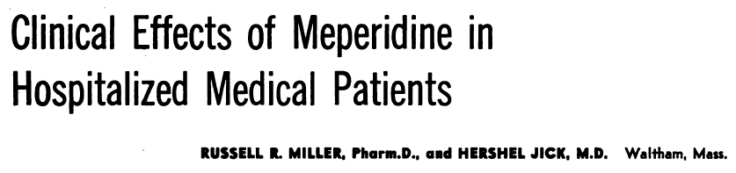
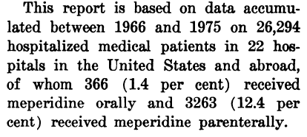

Slide 9
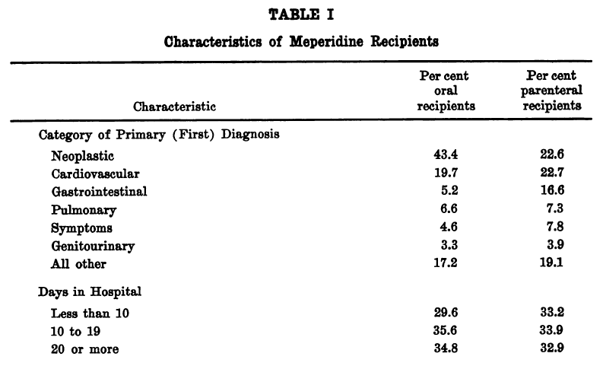

Slide 10
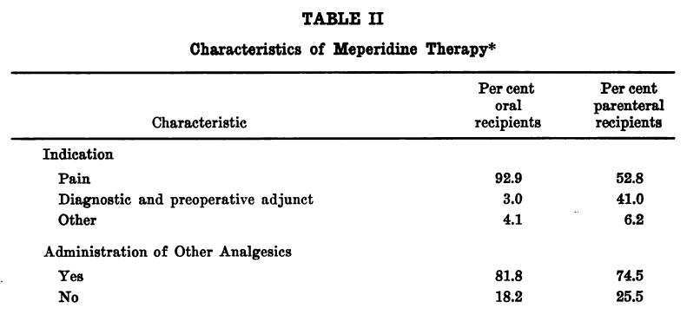

Slide 11
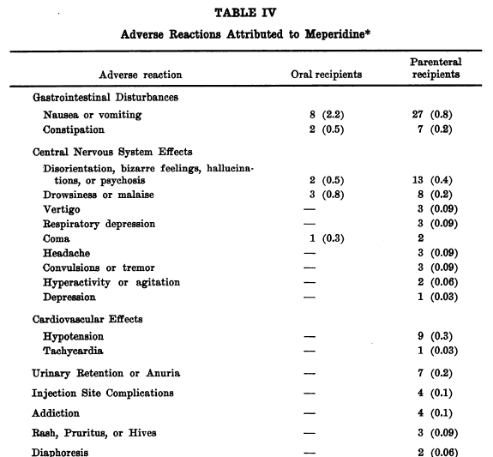

Slide 12
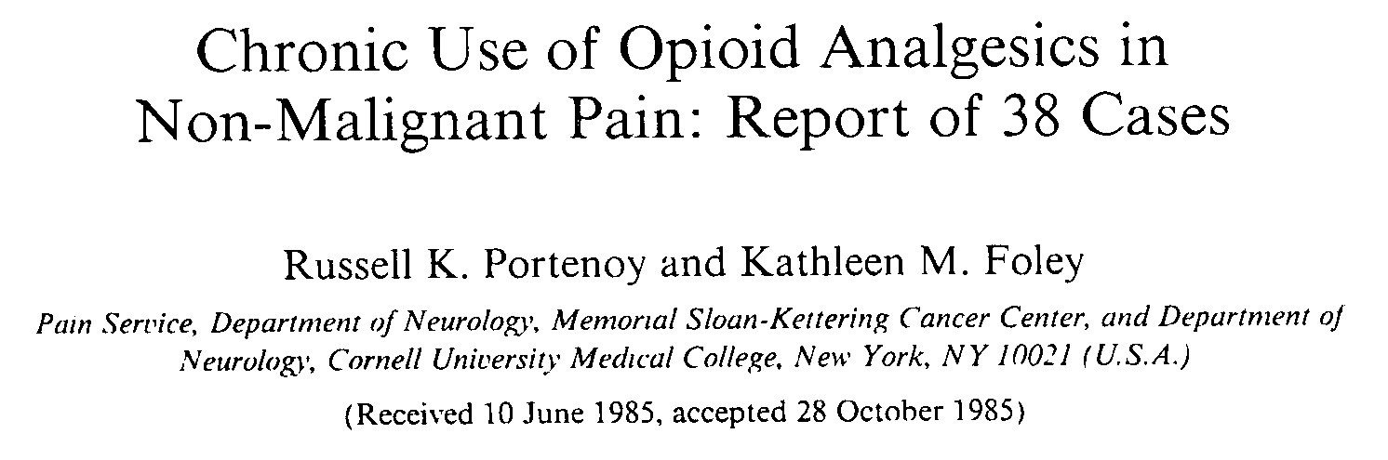
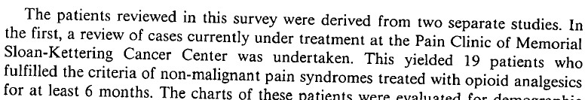

Slide 13
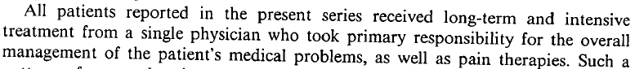

Slide 14
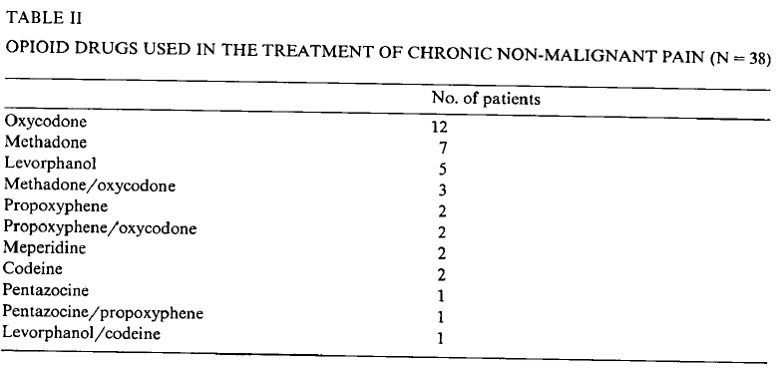
oxycodone
(12)

Slide 15
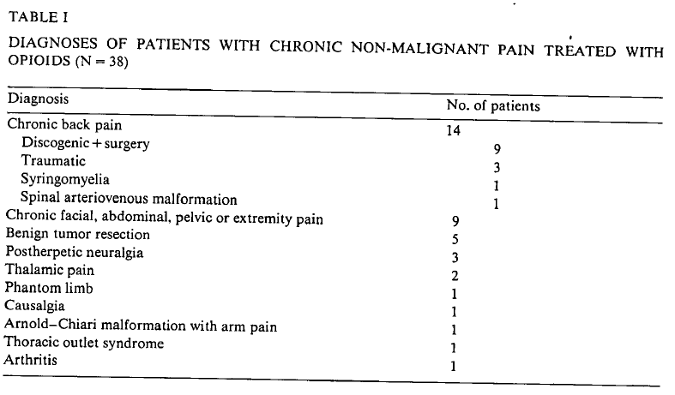
back pain
(14)

Slide 16
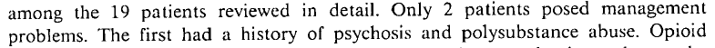
oxycodone
back pain
(12)
(14)
no management problems
(17)

Slide 17
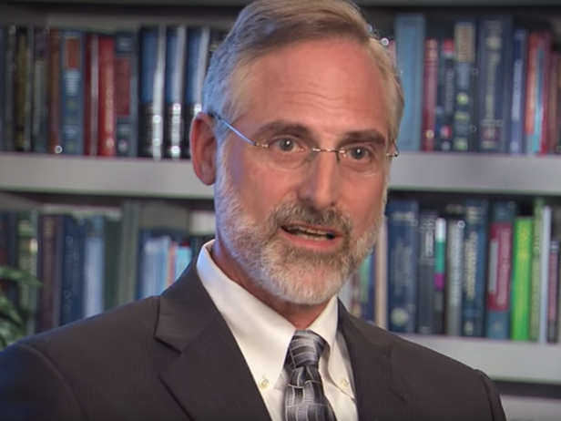

Slide 18

The ball is now in your court… Do you prescribe or not?
Provide an analysis… …that leads you to your decision

Slide 19
Welcome to Molecular Biology Through Discovery Tuesday, 14 March 2017

Slide 20
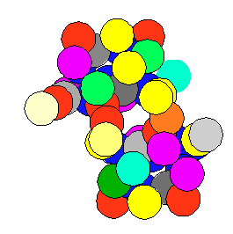
Central Dogma: DNA to RNA to Protein
Replication
DNA
Processing / Translocation
I'd like to discuss SQ14 and 15. What is the supernatant RNA Crick is referring to that is too short to code and too long to join to template RNA in the Soluble RNA section.

Slide 21
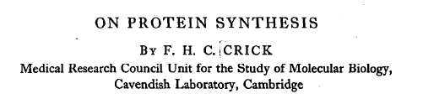
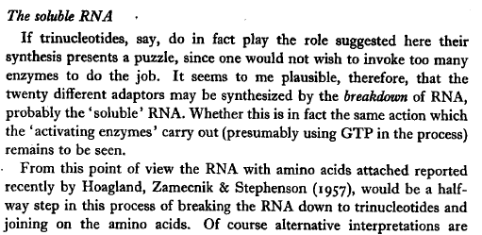

Slide 22
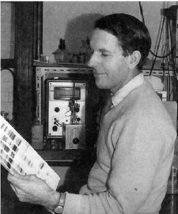
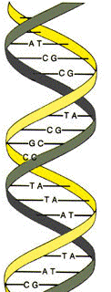
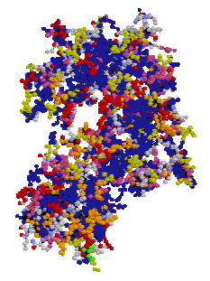
Information
Structure + Function
+ Self-assembly
C G A C C A T C G C C T T A G T A C
DNA
Protein

Slide 23
Information
Structure + Function
+ Self-assembly
{A - Alanine C - Cysteine D – Aspartate . . . Y – Tyrosine}
{A,C,G,T}
4 letters
20 letters

Slide 24
Central Dogma: DNA to RNA to Protein
Replication
DNA
Processing / Translocation

Slide 25
Central Dogma: DNA to RNA to Protein

Slide 26
Central Dogma: DNA to RNA to Protein

Slide 27
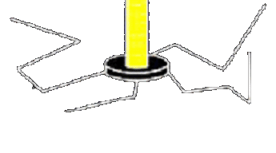
Translation per Crick (1950’s)
Ribosomes are RNA + protein
Viruses (some) are RNA + protein
Ribosomes are viruses
=

Slide 28
Translation per Crick (1950’s)
RNA replicates
RNA breaks down
Amino acids attach to triplet RNA

Slide 29
Translation per Crick (1950’s)
Triplet RNA attach to ribosomal RNA
Amino acids link together
Protein!
Protein
SQ15. Anything missing from this scenario? Other problems you see with it? .

Slide 30
Translation per Crick (1950’s)
SQ14. Why did he like three? What was his problem with longer than three? .

Slide 31

Why an adapter of 3 nucleotides?

Slide 32
Central Dogma: DNA to RNA to Protein
Replication
DNA
Processing / Translocation
My question is, why do we need mRNA and tRNA? .

Slide 33
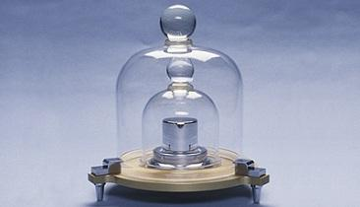
Why mRNA?

Slide 34
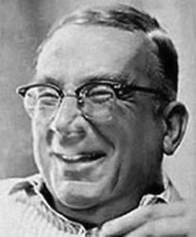
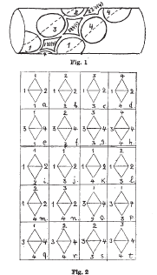
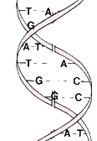
Why tRNA?
George Gamow
Problem Set 5, #7

Slide 35
Length of nucletotide:amino acid
0.35 nm
0.34 nm

Slide 36
Why tRNA?
George Gamow
Problem Set 5, #7

Slide 37
Welcome to Molecular Biology Through Discovery Tuesday, 14 March 2017

Slide 38
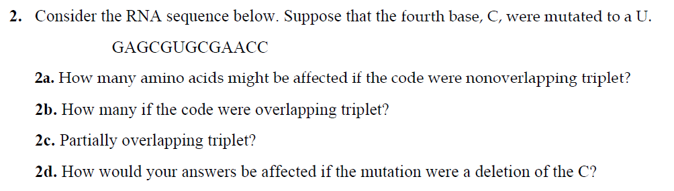
Problem Set 5, #2

Slide 39
Problem Set 5, #5

Slide 40
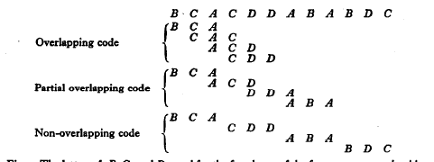
Types of Genetic Codes
Length – Duplet, Triplet, Variable,..
Degeneracy – Degenerate, non-degenerate
Overlap – (partially-, non-) overlapping

Slide 41
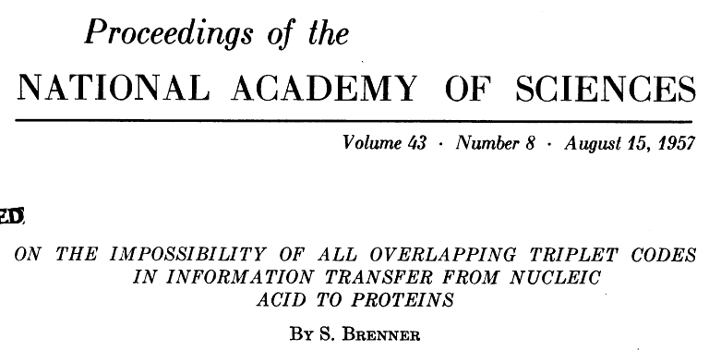
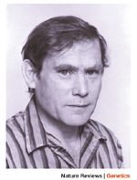
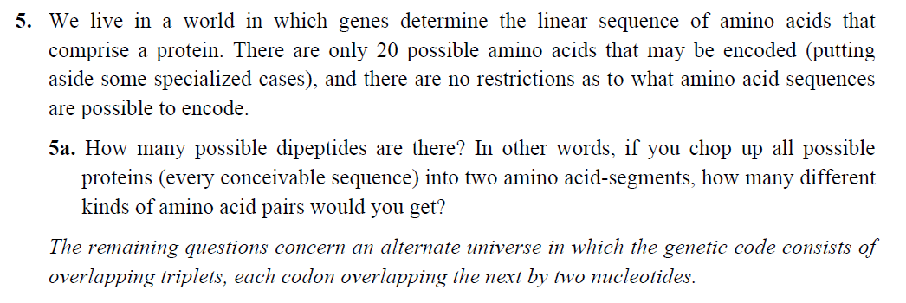
Problem Set 5, #5
Sydney Brenner

Slide 42

Problem Set 5, #2,#5
Me
1N
1S
2N
2S
3N
3S
4N
4S
5N
5S
6N
6S
7S

Slide 43
Problem Set 5, #2,#5
Me
Connect to: https://vcu.zoom.us/j/2504526209
1N
1S
2N
A
B
C
D
2S
3N
3S
4N
E
F
G H
4S
5N
5S
6N
I J
K
L
6S
7S

